Slide 1
Magnetic Sensor Tracking Angle Corrected
02/13/2024

Slide 2
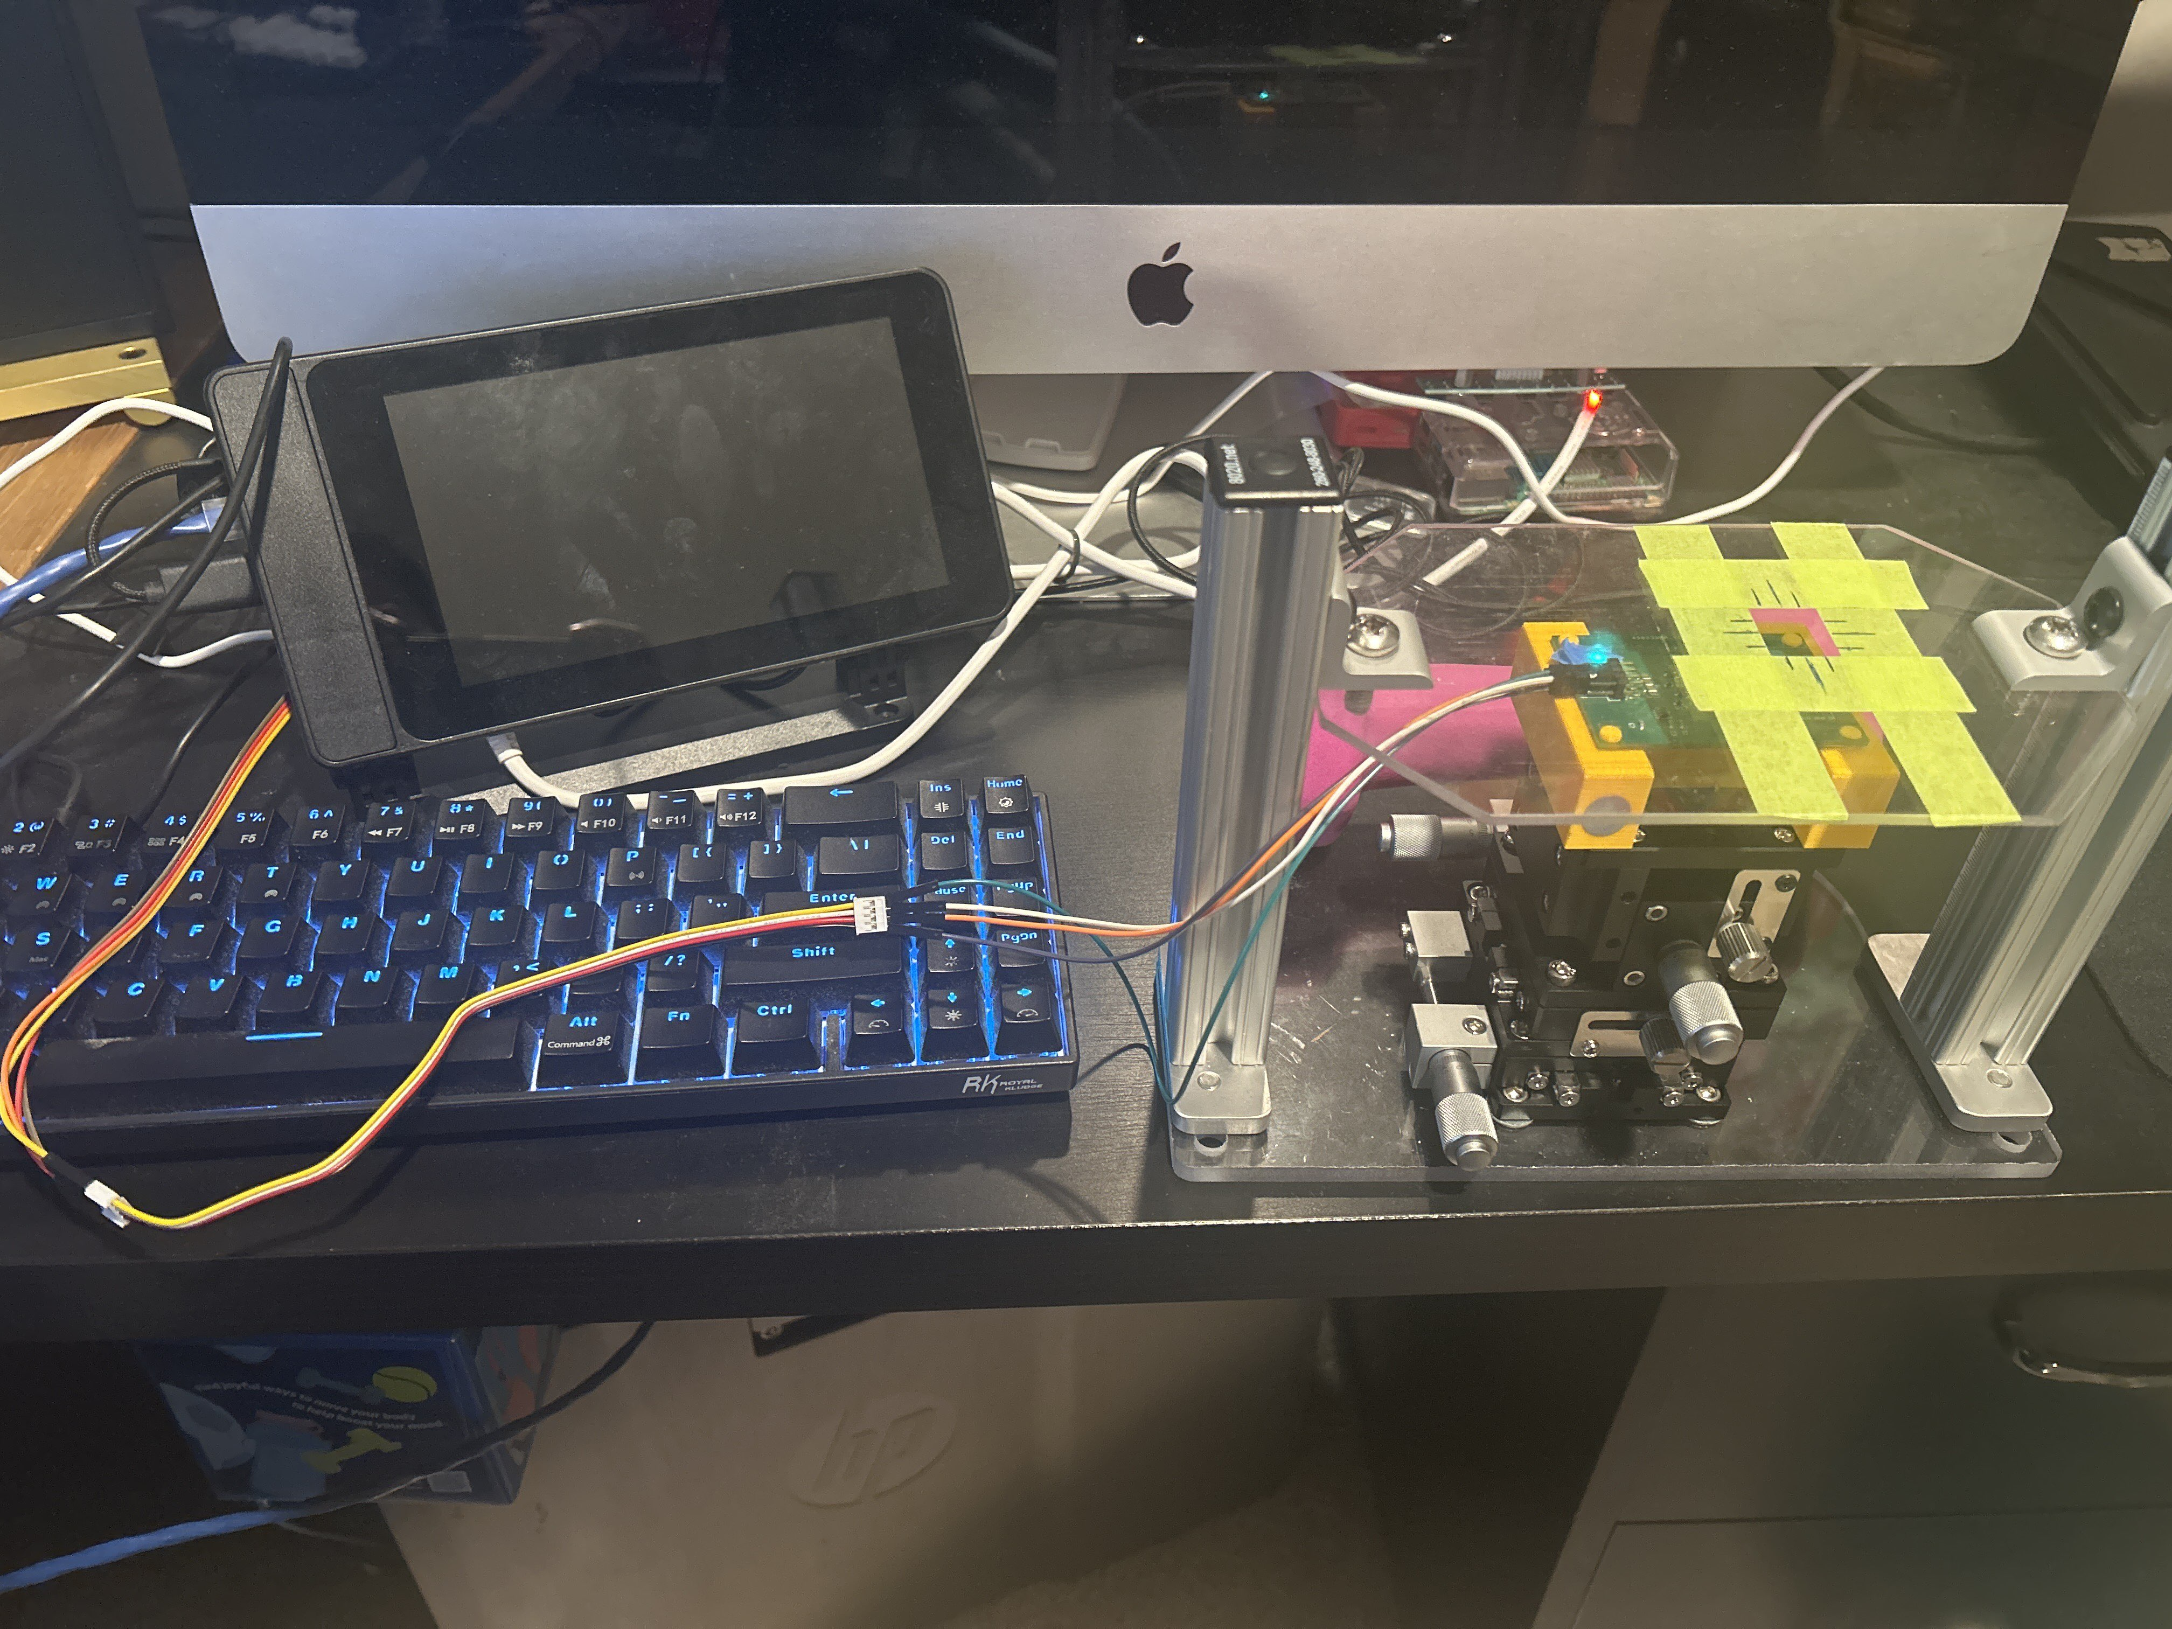

Slide 3
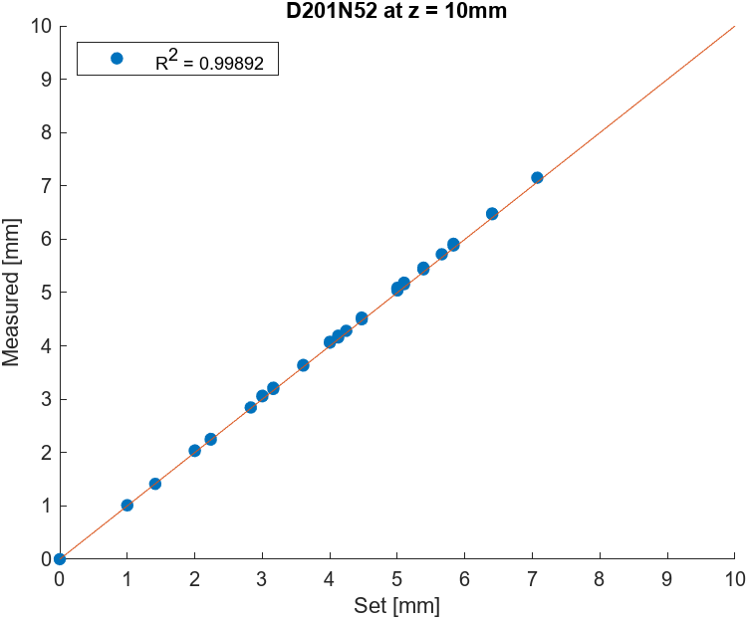
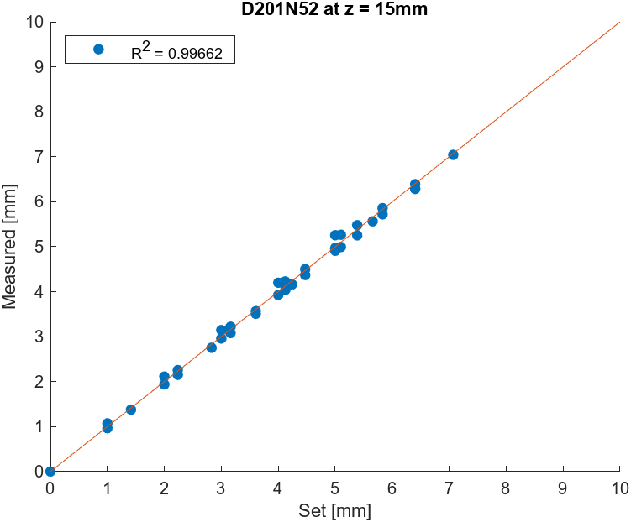
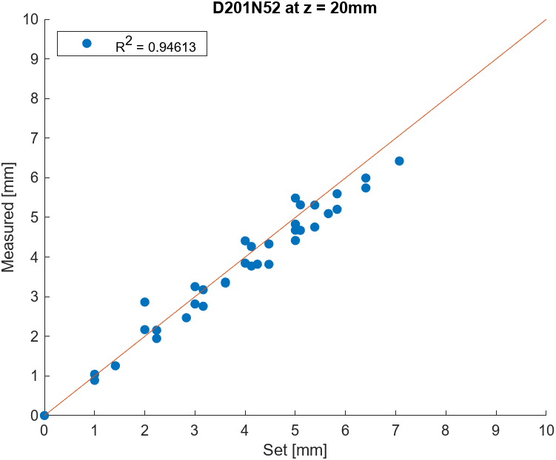
D201-N52: D = 3.175mm, H =0.79mm

Slide 4
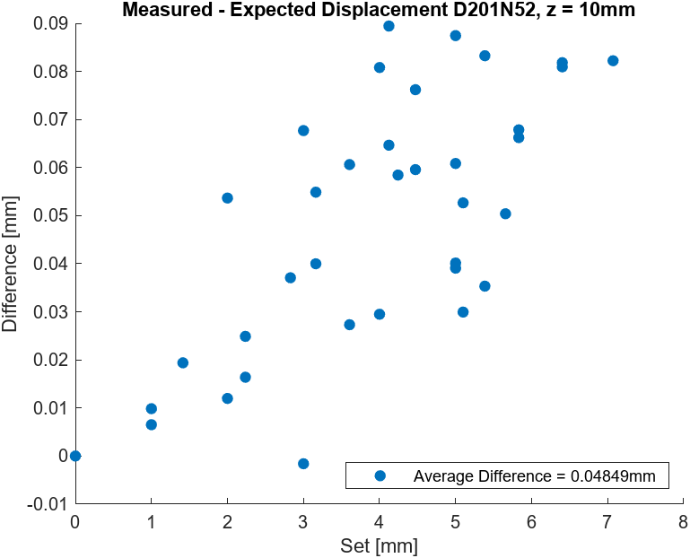
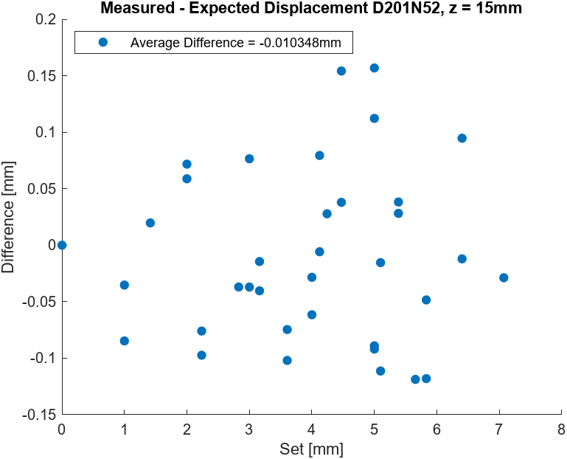
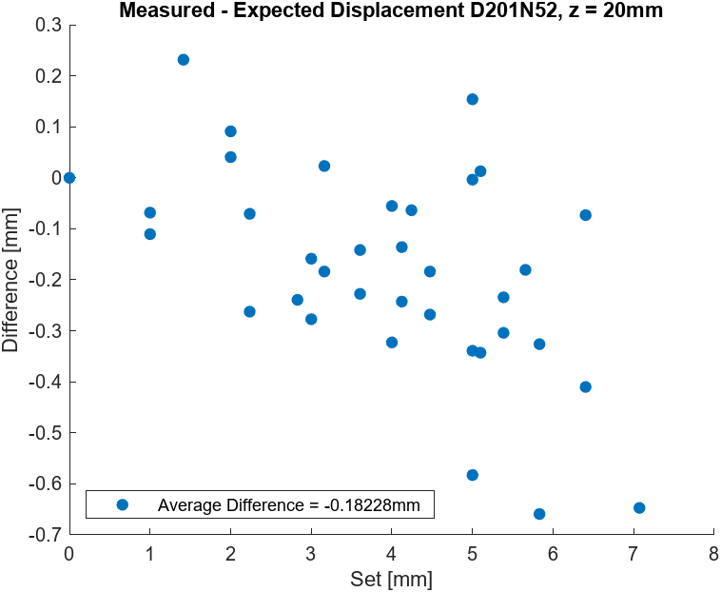
D201-N52: D = 3.175mm, H =0.79mm

Slide 5
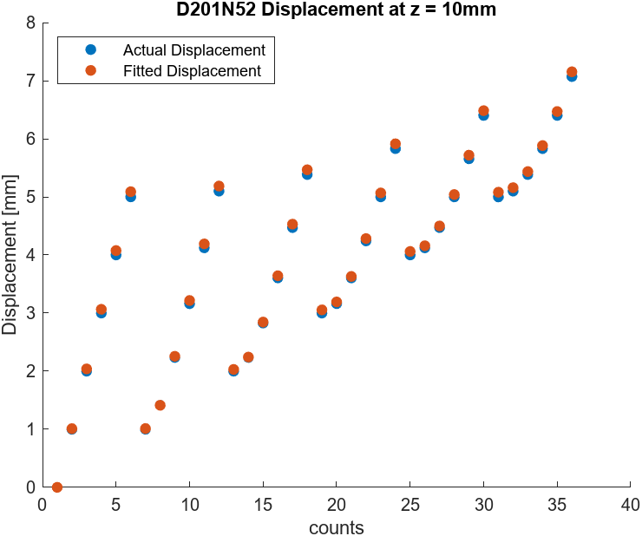
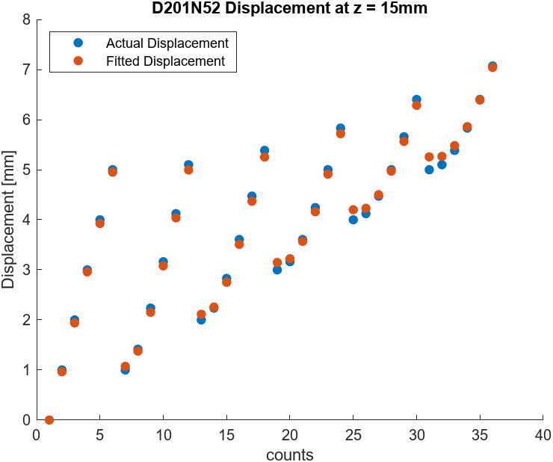
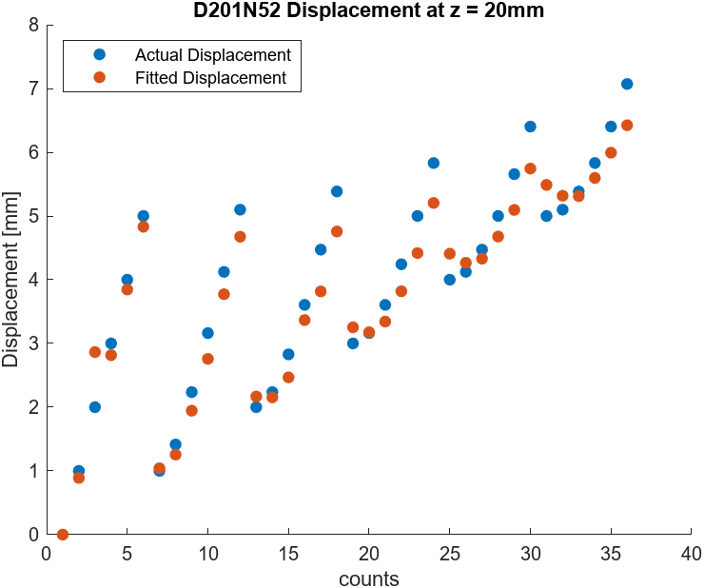
D201-N52: D = 3.175mm, H =0.79mm

Slide 6
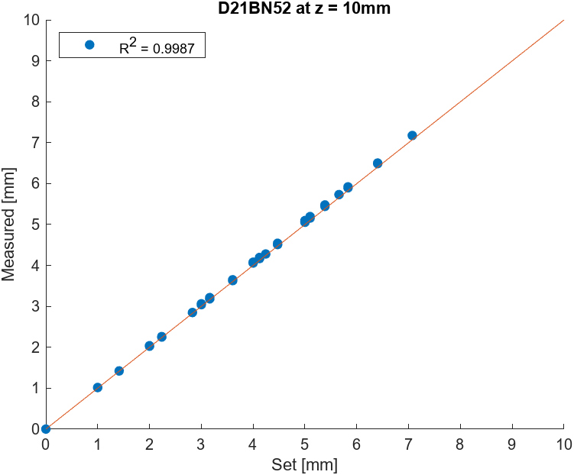
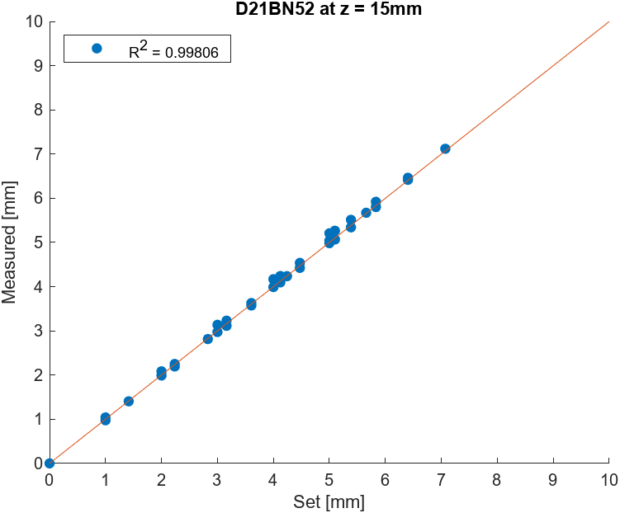
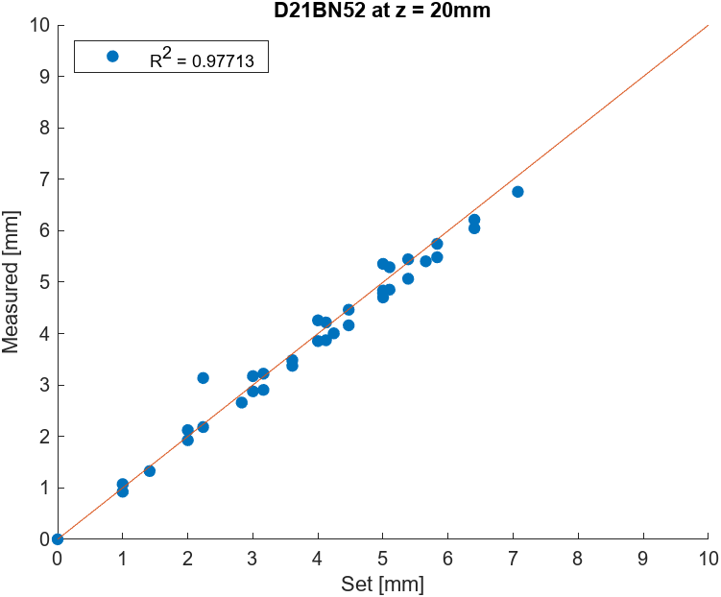
D21-N52: D = 3.175mm, H =1.59mm

Slide 7
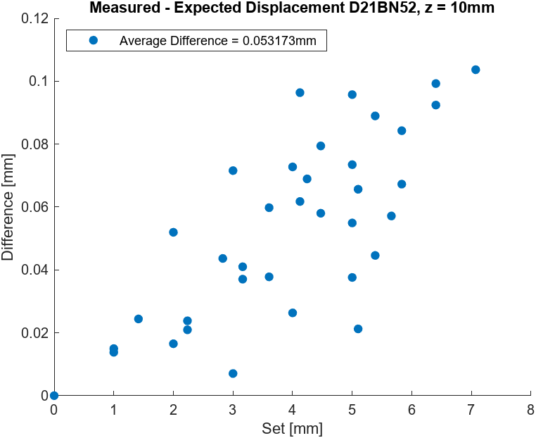
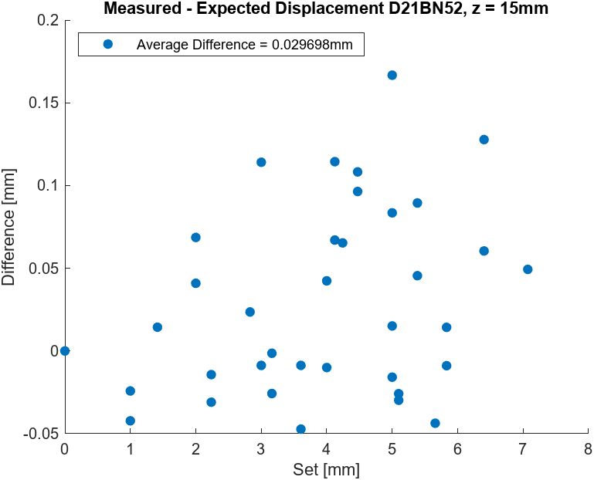
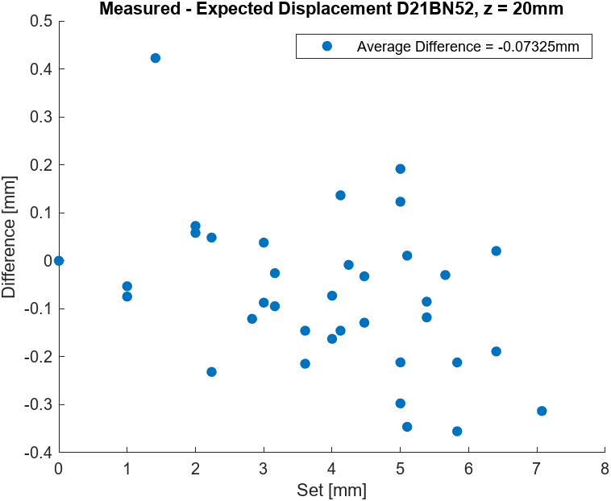
D21-N52: D = 3.175mm, H =1.59mm

Slide 8
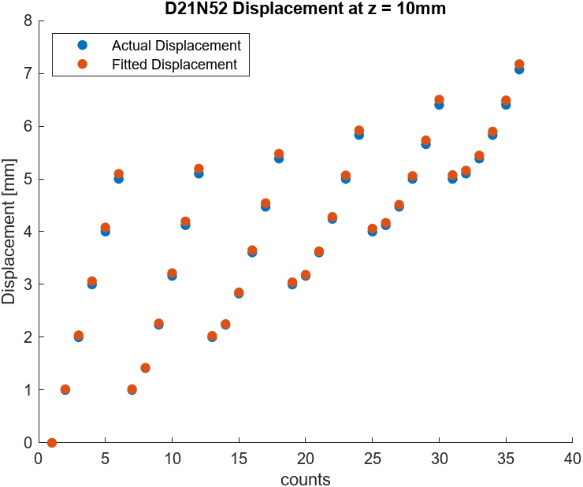
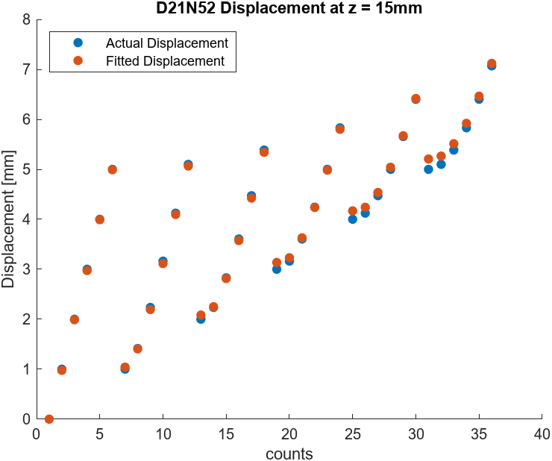
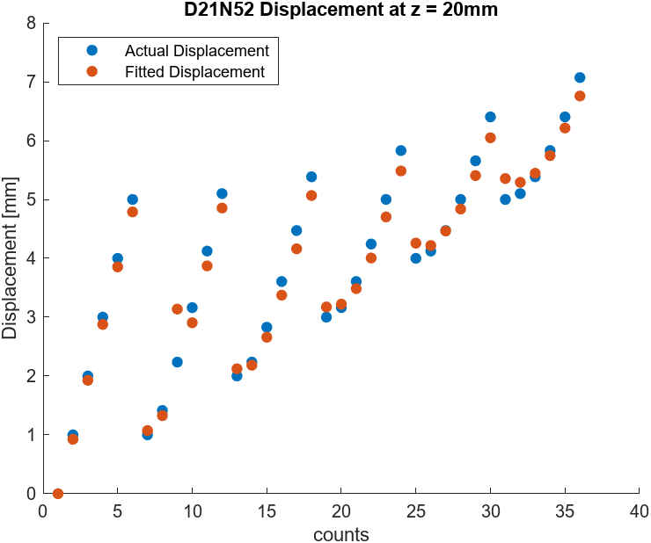
D21-N52: D = 3.175mm, H =1.59mm

Slide 9
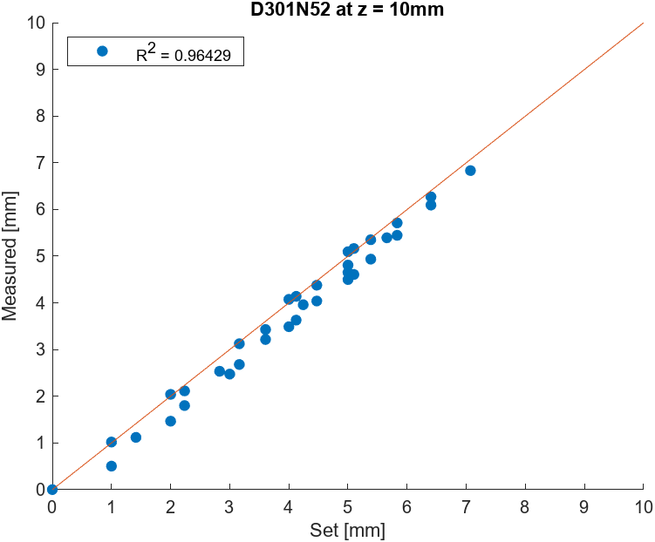
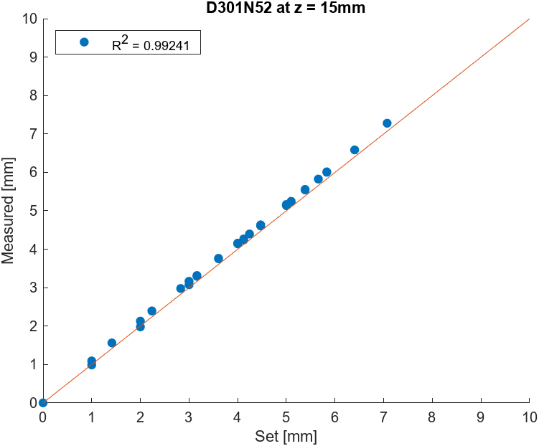
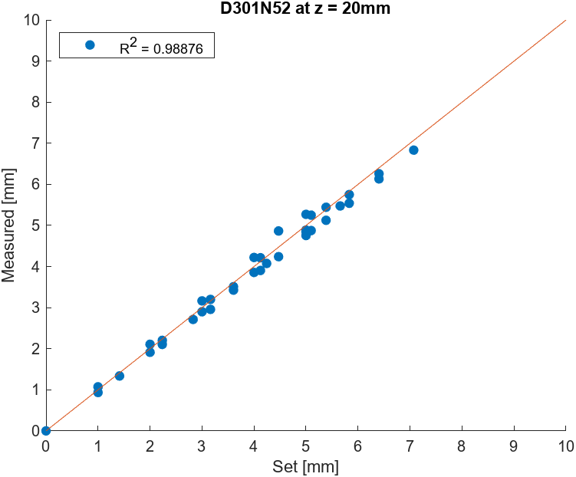
D301-N52: D = 4.76mm, H =0.79mm

Slide 10
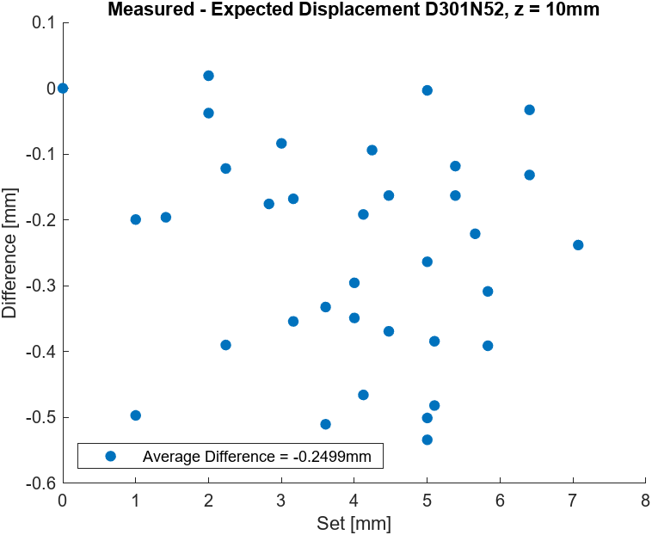
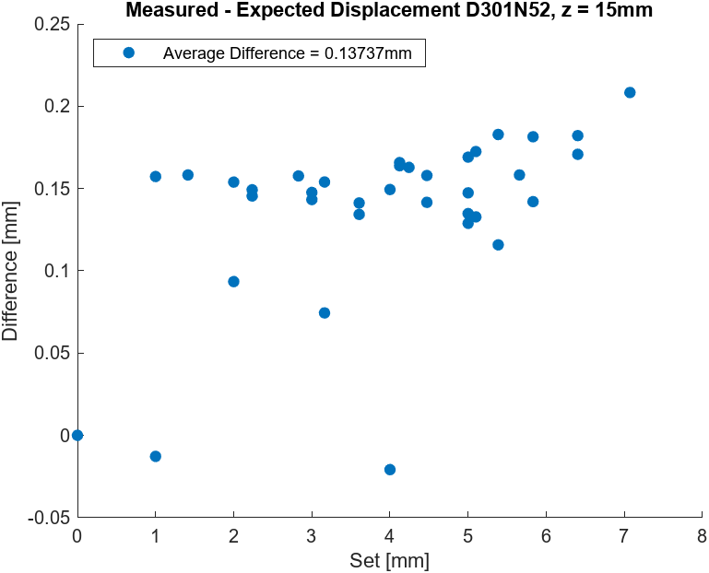
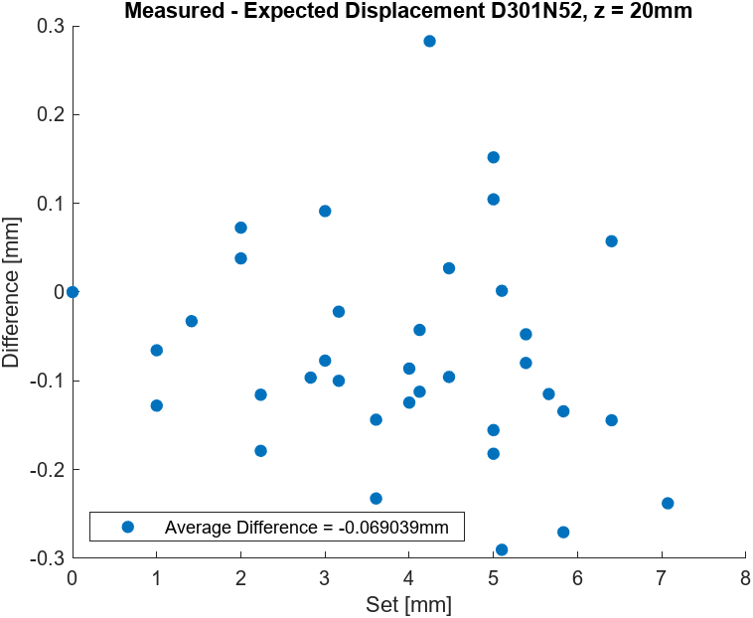
D301-N52: D = 4.76mm, H =0.79mm

Slide 11
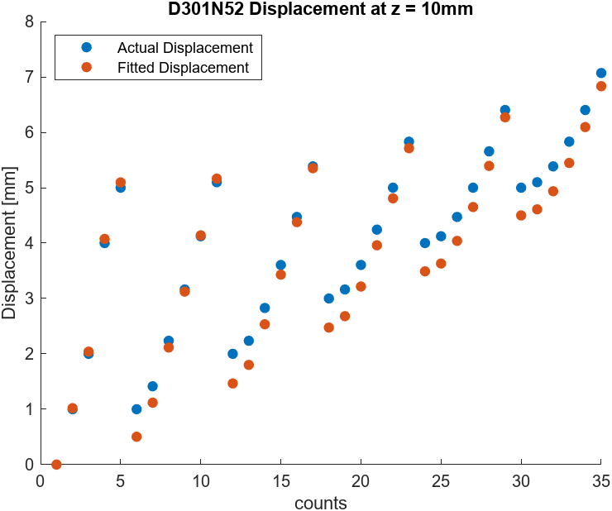
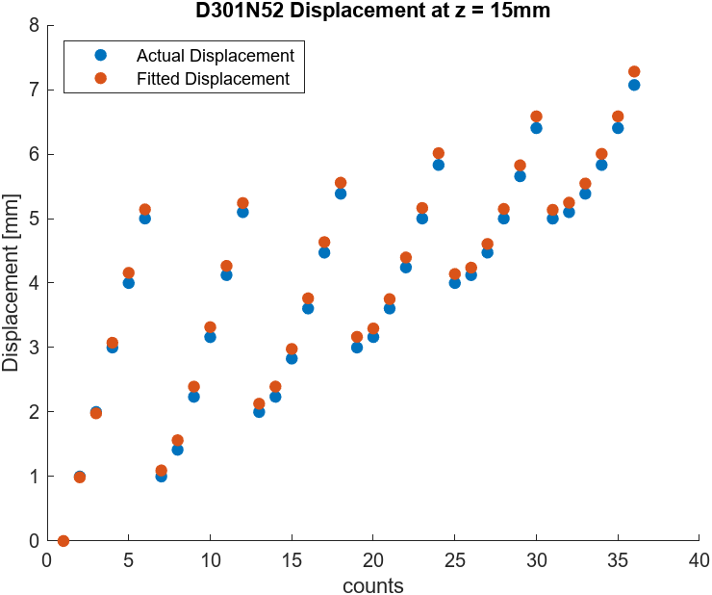
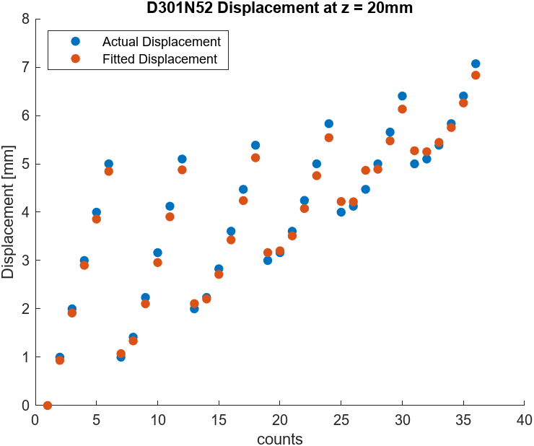
D301-N52: D = 4.76mm, H =0.79mm

Slide 12
D31-N52: D = 4.76mm, H =1.59mm

Slide 13
D31-N52: D = 4.76mm, H =1.59mm

Slide 14
D31-N52: D = 4.76mm, H =1.59mm

Slide 15
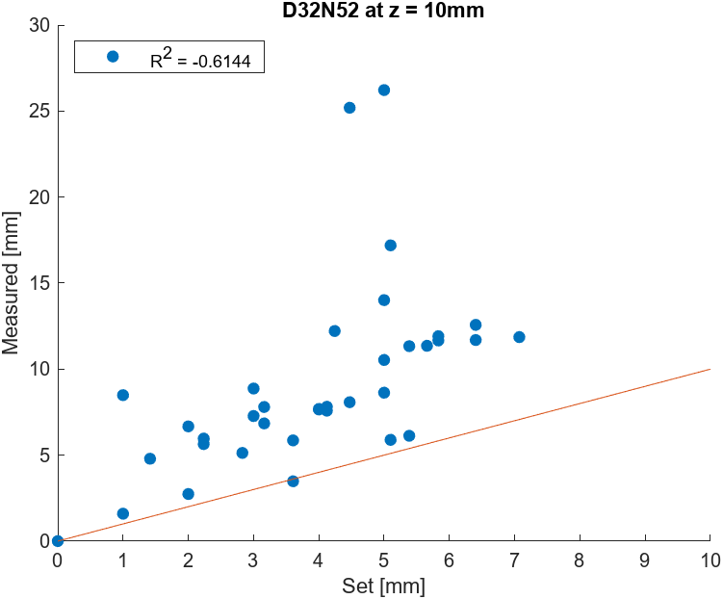

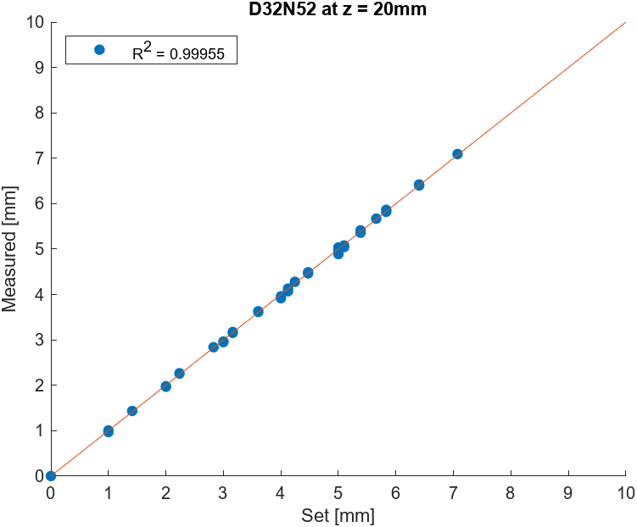
D32-N52: D = 4.76mm, H =3.18mm

Slide 16
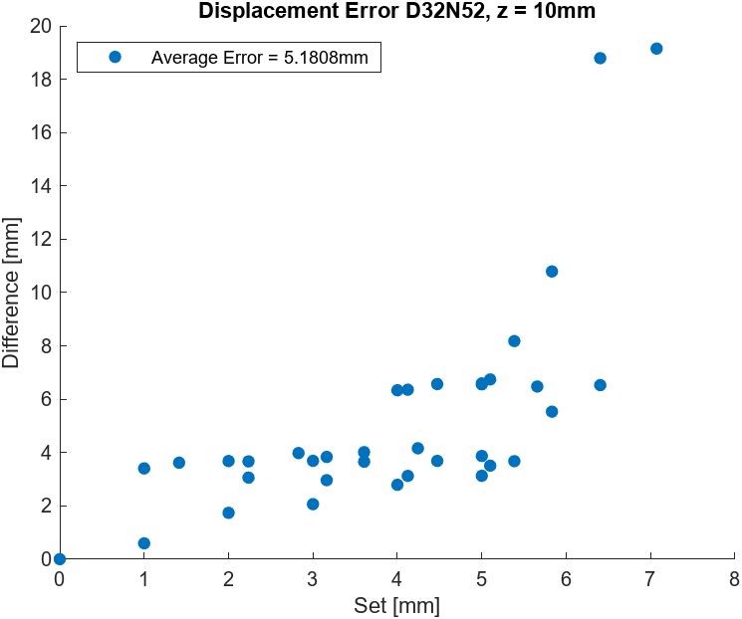
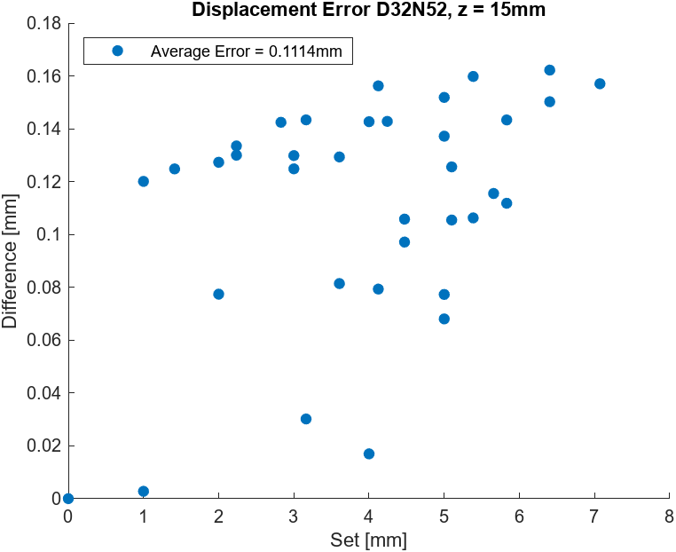
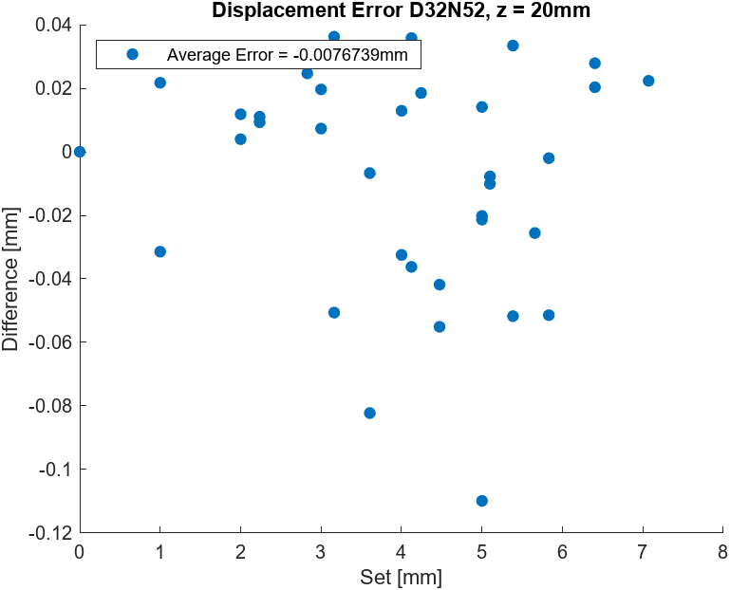
D32-N52: D = 4.76mm, H =3.18mm

Slide 17
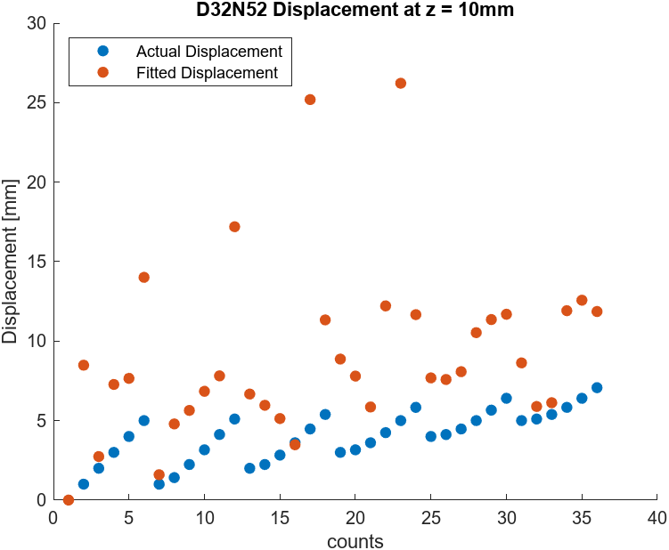
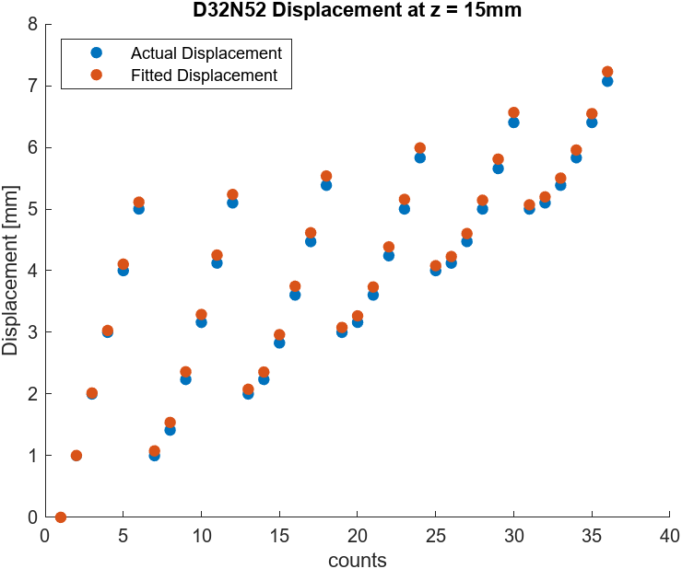
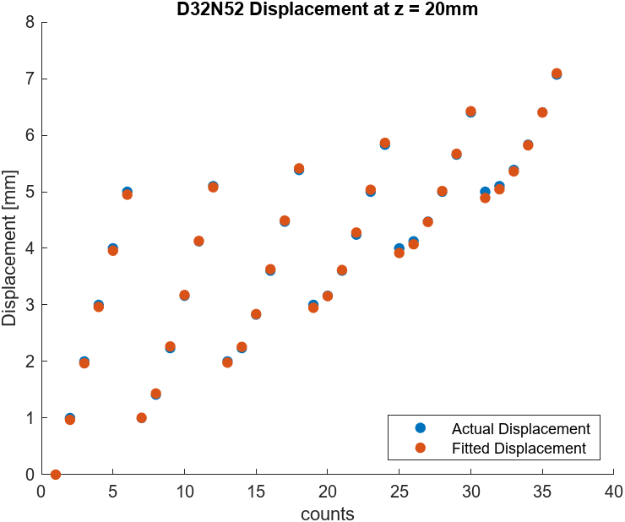
D32-N52: D = 4.76mm, H =3.18mm

Slide 18
Magnetic Sensor Tracking
02/14/2024

Slide 19

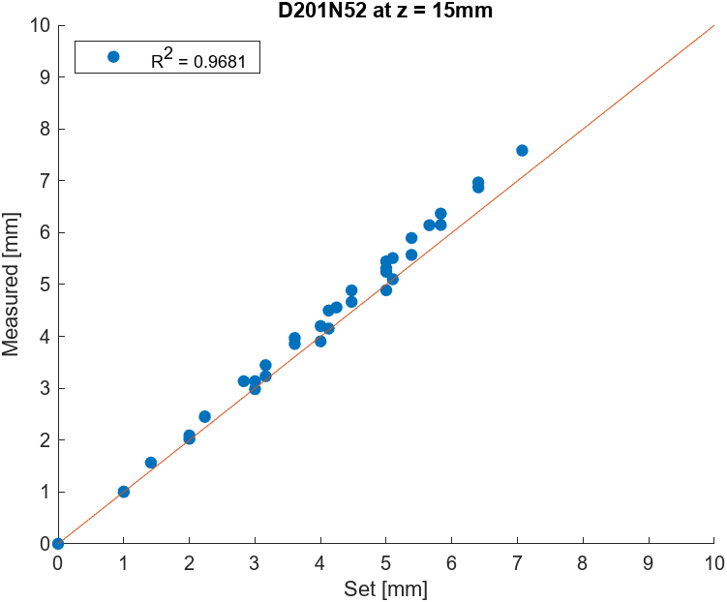
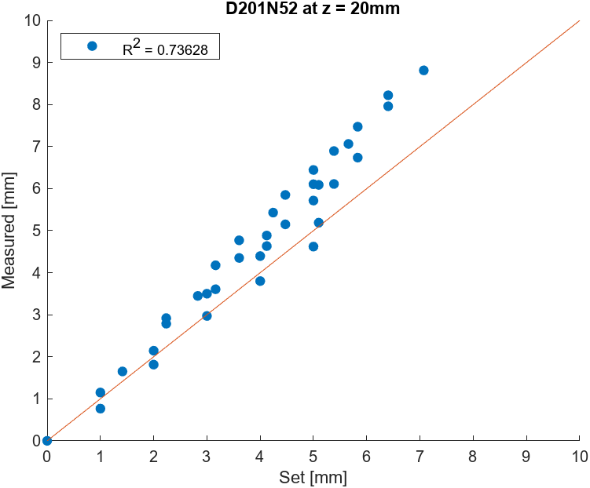
D201-N52: D = 3.175mm, H =0.79mm

Slide 20
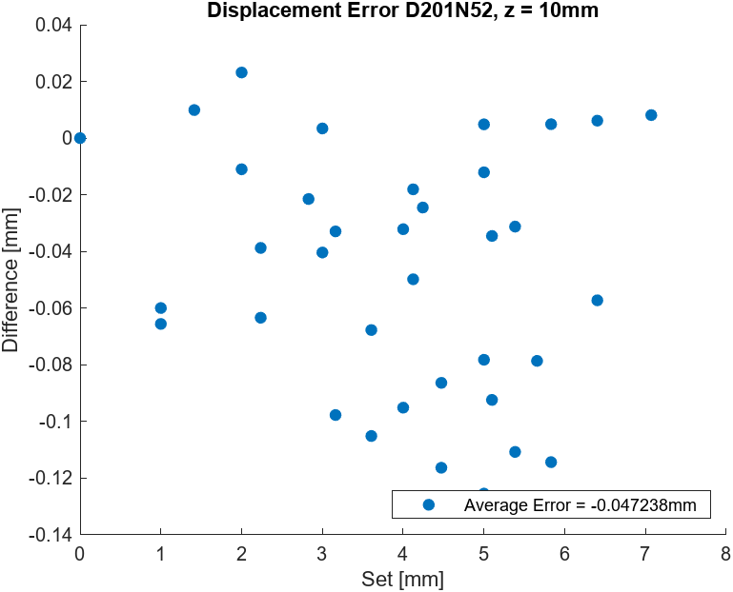
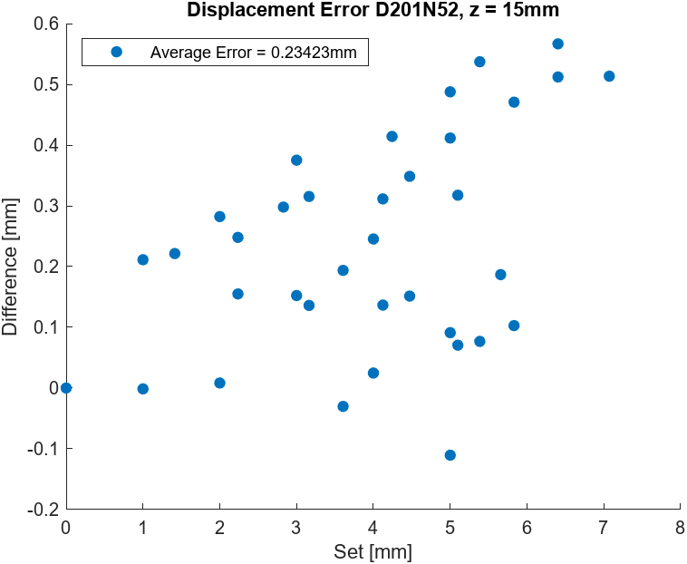
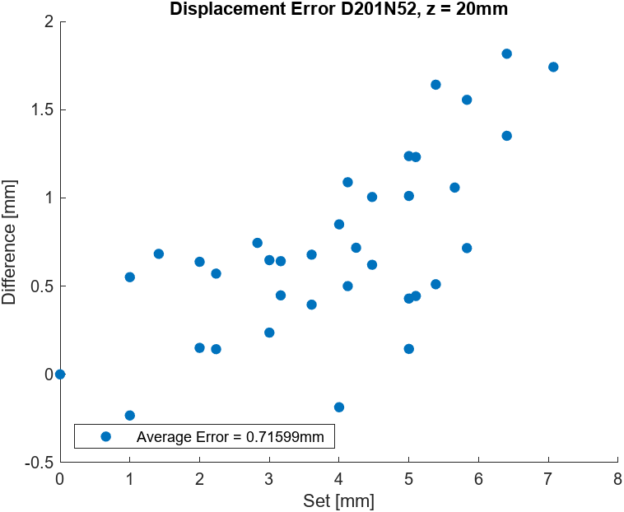
D201-N52: D = 3.175mm, H =0.79mm

Slide 21
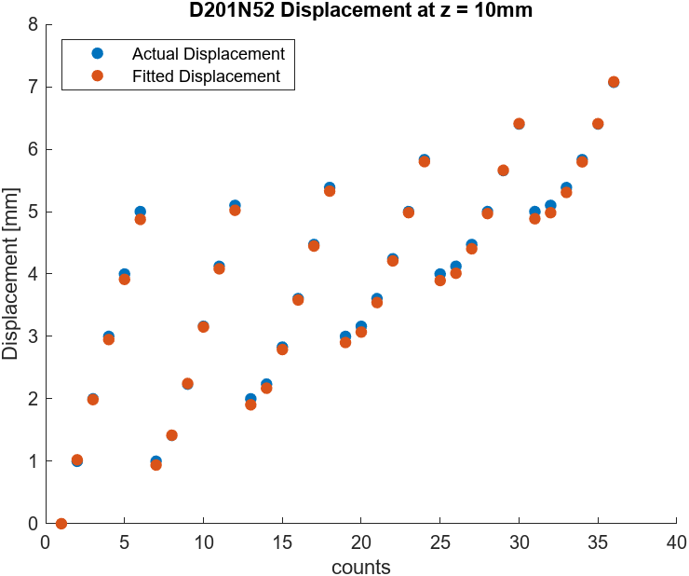
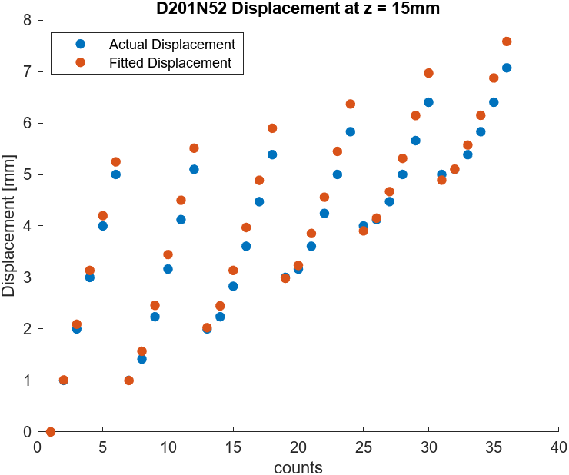
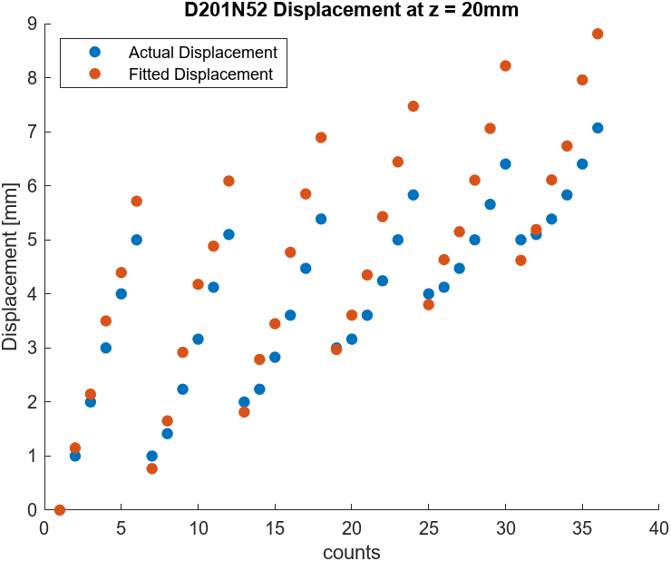
D201-N52: D = 3.175mm, H =0.79mm

Slide 22

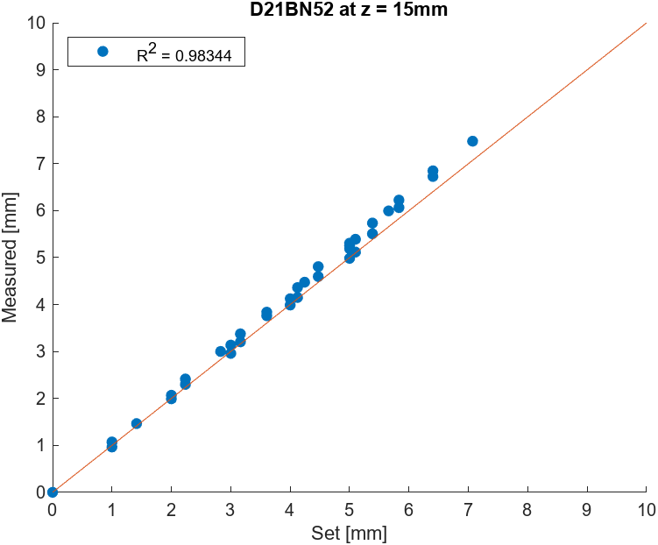
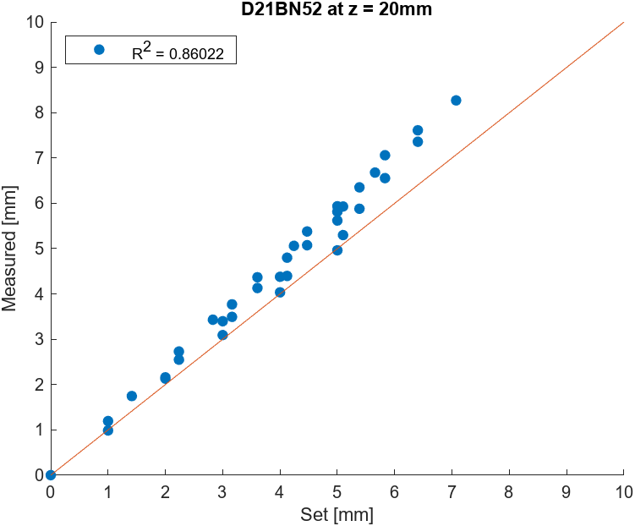
D21B-N52: D = 3.175mm, H =1.59mm

Slide 23
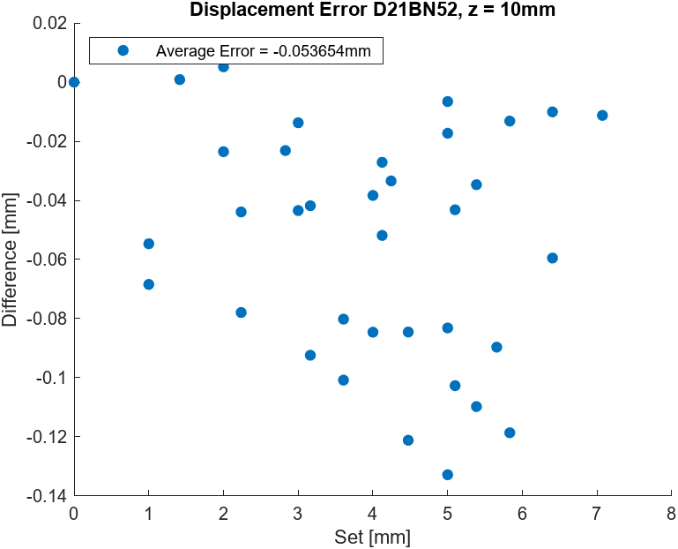
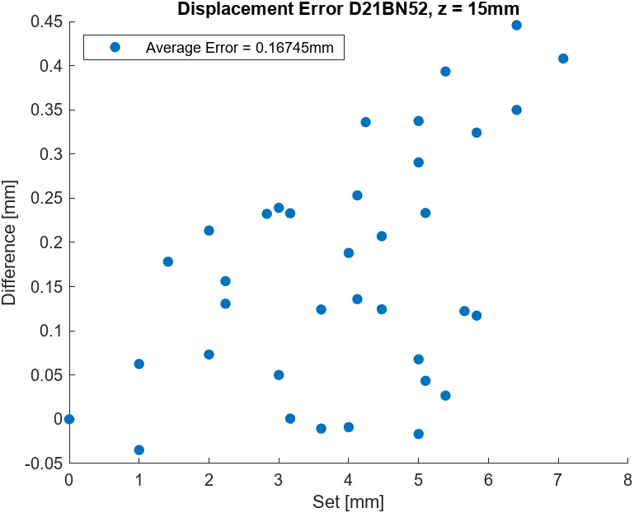
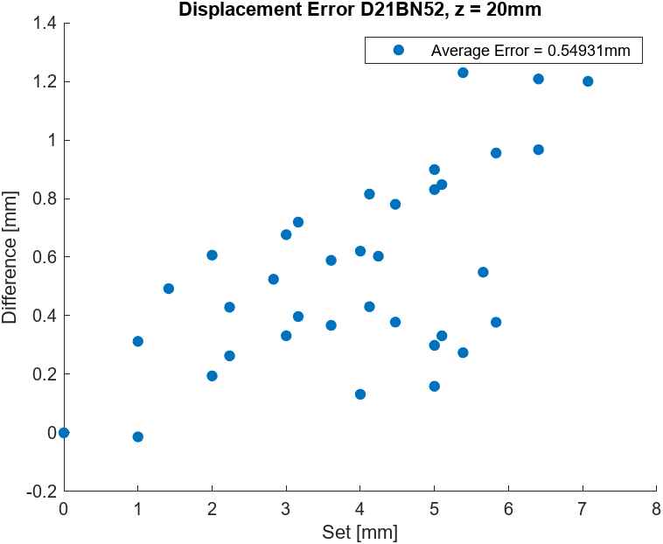
D21B-N52: D = 3.175mm, H =1.59mm

Slide 24
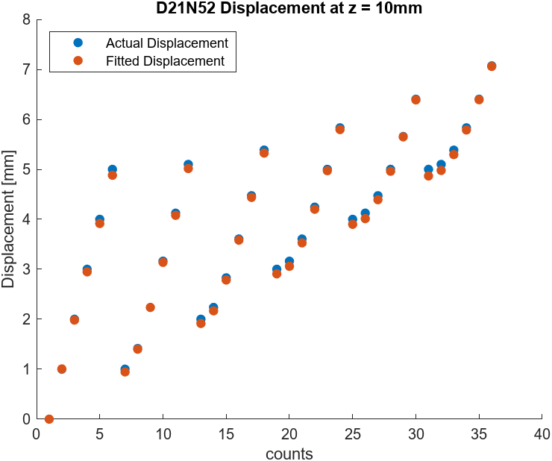


D21B-N52: D = 3.175mm, H =1.59mm

Slide 25



D301-N52: D = 4.76mm, H =0.79mm

Slide 26



D301-N52: D = 4.76mm, H =0.79mm

Slide 27



D301-N52: D = 4.76mm, H =0.79mm

Slide 28



D31-N52: D = 4.76mm, H =1.59mm

Slide 29



D31-N52: D = 4.76mm, H =1.59mm

Slide 30



D31-N52: D = 4.76mm, H =1.59mm

Slide 31

D31-N52: D = 4.76mm, H =1.59mm

Slide 32

D31-N52: D = 4.76mm, H =1.59mm

Slide 33

D31-N52: D = 4.76mm, H =1.59mm

Slide 34



D31-N52: D = 4.76mm, H =1.59mm

Slide 35



D31-N52: D = 4.76mm, H =1.59mm

Slide 36



D31-N52: D = 4.76mm, H =1.59mm

Slide 37



D32-N52: D = 4.76mm, H = 3.18mm, gain = 4
Gain = 4 (lower resolution)

Slide 38



D32-N52: D = 4.76mm, H = 3.18mm, gain = 4

Slide 39



D32-N52: D = 4.76mm, H = 3.18mm, gain = 4

Slide 40



D32-N52: D = 4.76mm, H = 3.18mm, gain = 4

Slide 41



D32-N52: D = 4.76mm, H = 3.18mm, gain = 4

Slide 42



D32-N52: D = 4.76mm, H = 3.18mm, gain = 4

Slide 43


R^2 vs Distance

Slide 44


R^2 vs Distance

